Slide 1

STM32WBA The New and Better - Hands On
Manuel Marcias – South EMEA STM32FAE

Slide 2
Agenda
1
Prerequisites
2
Hands On Purpose
3
How to start WBA evaluation ?
4
Hands On: Let’s build P2P server with STM32Cube tools
5
Hands On: BLE sequences clarification
6
ST EMEA TOMAS support
7
STM32WBA Take Away

Slide 3
Prerequisites

Slide 4
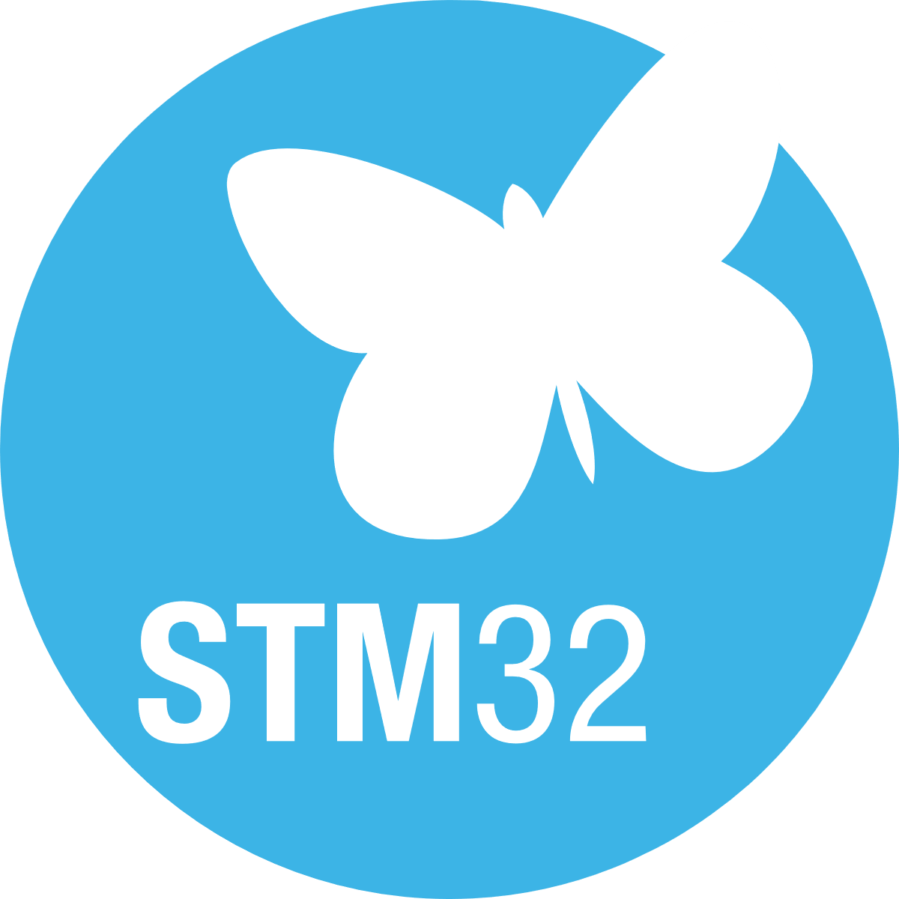
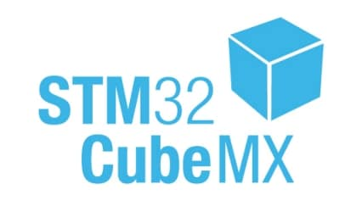

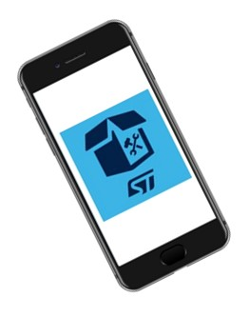
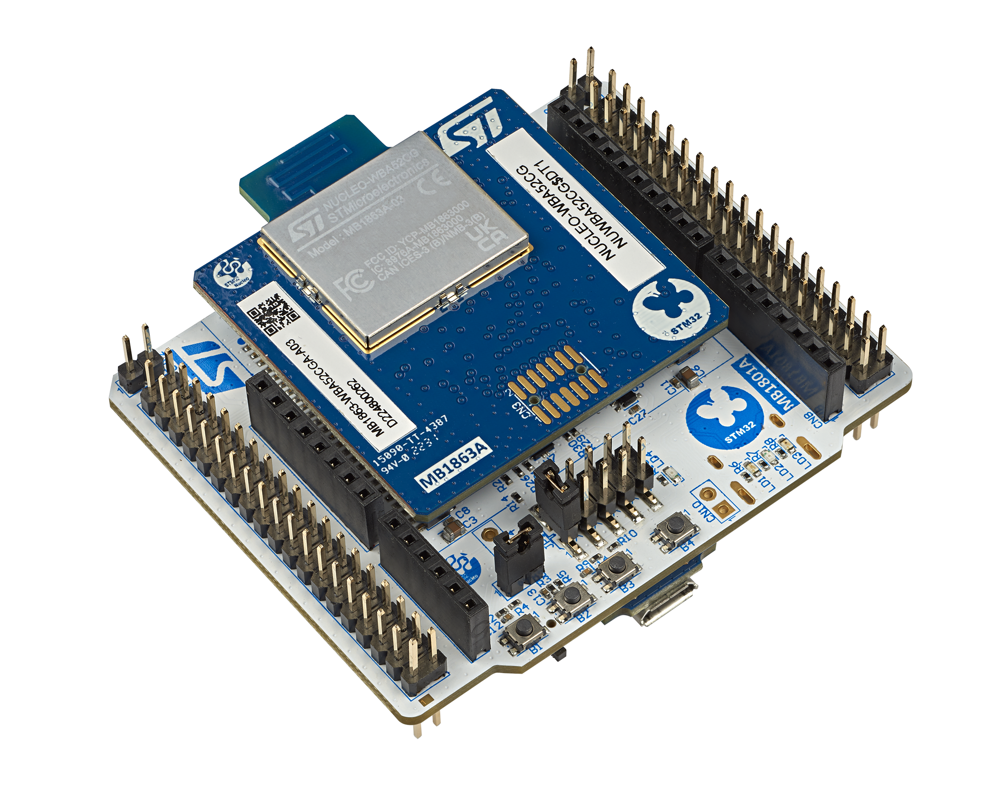
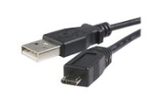

Prerequisites Refresh
STM32WBA Workshop - preparation before the session
undefined (rristm.github.io)
STM32CubeWBA MCU package (v1.1.0 or up)
IDE: STM32CubeIDE v 1.13.1
A serial terminal (e.g. TeraTerm)
ST BLE ToolBox Smartphone application
NUCLEO-WBA52
USB A to Micro-B Cable
SW prerequisites
HW prerequisites
ST BLE Toolbox

Slide 5
Hands On Purpose

Slide 6


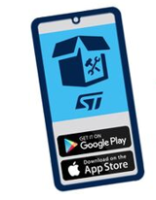
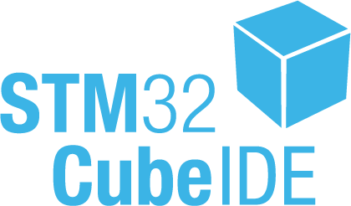



Hands On Purpose
The purpose of this session is to start from an existing project example BLE_P2PServer & modify this code example to customize advertising data (Local name).
During this Hands-on session, we will use ST tool STM32CubeMX & STM32CubeIDE to generate associated code, flash and test over Nucleo-WBA5x board.
BLE_P2PServer Application
STM32WBA52
BLE_P2PServer

Slide 7
How to start WBA evaluation ?

Slide 8
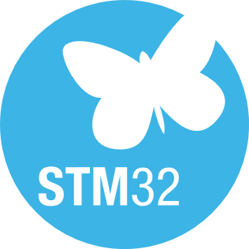

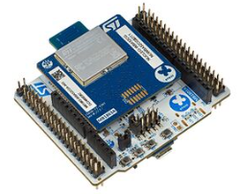
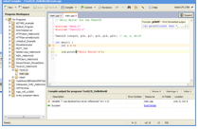
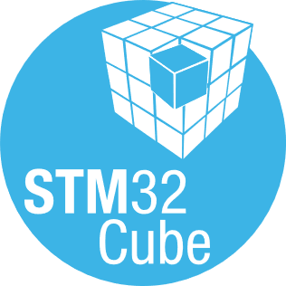
How to start with STM32WBA
Complete set of documentation
#1 understand
Powerful turnkey code examples
#2 evaluate & prototype
NUCLEO-WBA52CG
A complete ecosystem
#3 start design
Notes:
The pitch
#1 start from doc & wiki to understand products capabilities , architecture & APIs
#2 thanks to STM32WBACube SW evaluate and prototype BLE & peripherals (in sense of drivers) based on existing code
#3 CubeMx to ease your design.

Slide 9

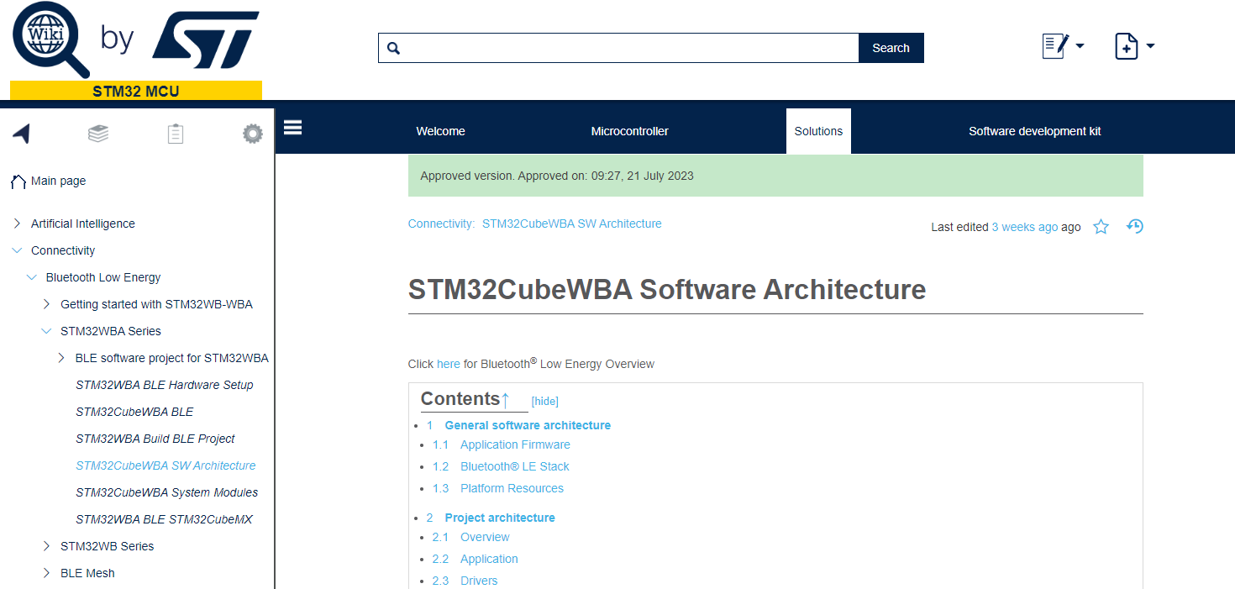

A complete set of documentation Getting started
STM32WBA Wiki page - Start to learn & play
Getting started
code architecture
Application code explantations & tips
certification process
https://wiki.st.com/stm32mcu/wiki/Category:Getting_started_with_STM32WB-WBA#Bluetooth-C2-AE_LE_overview
AN & HW guidance @st.com – Deep dive on product APIs
AN5928 - How to build a short range wireless application with STM32WBA MCUs
PM0271Guidelines for Bluetooth® Low Energy stack programming on STM32WB/ STM32WBA MCUs
AN5042How to calibrate the HSE clock for RF applications on STM32 wireless MCUs

Slide 10
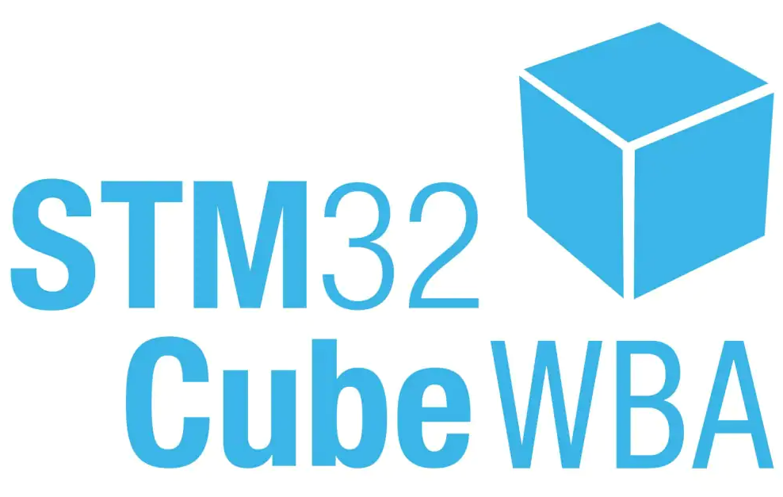
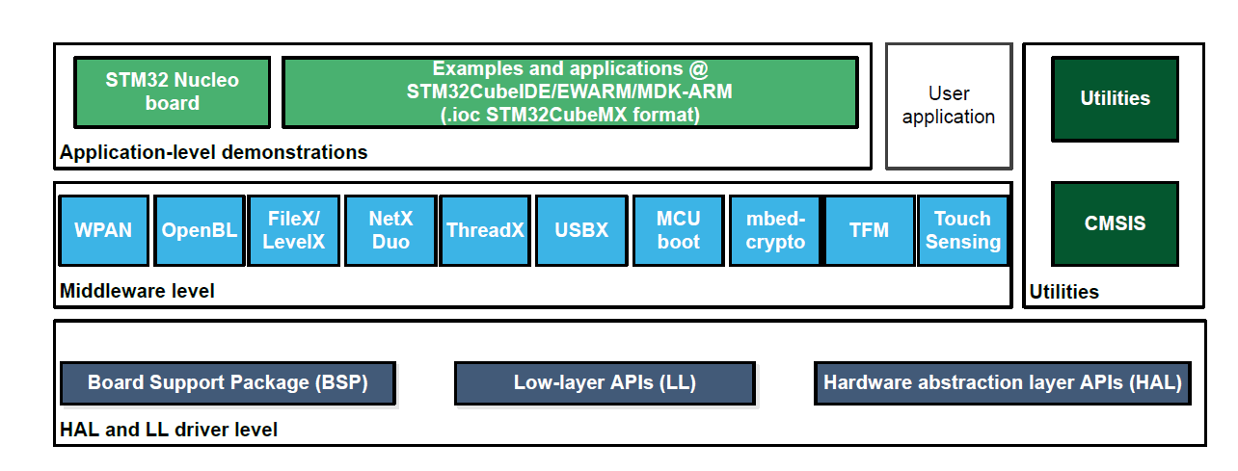
STM32CubeWBA Evaluate and start with existing code
Package Components in a Nutshell

Slide 11
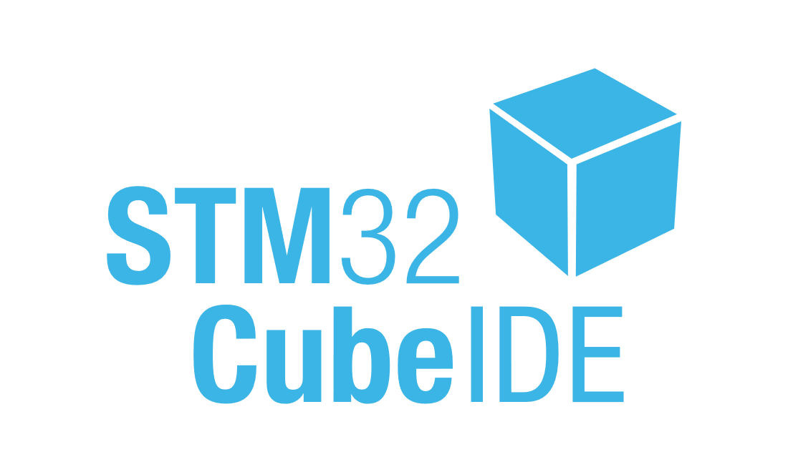



STM32CubeWBA Evaluate and start based on existing code
STM32CubeWBA MCU Package provides software components running on STM32WBA Series MCU
development environments
Application code : BLE , 802.15.4, Thread, Zigbee
Peripheral code examples
Utilies to ease application design : timer capabilities, sequencer, LCD
Firmware Package for the STM32WBA series is also available on STM32CubeWBA GitHub

Slide 12
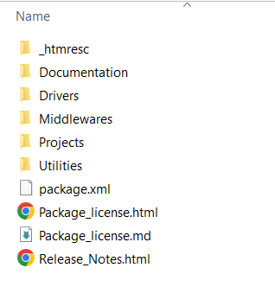
STM32CubeWBA Content 1/3
STM32CubeWBA MCU folder overview
Documentation includes STM32CubeWBA
Getting Started Guide
Driver includes BSP, CMSIS as well as HAL, LL for each peripheral
Consistent set of libraries such as Azure RTOS components such as ThreadX, FileX, LevelX, NetXDuo as well as STM32_WPAN, Touch Sensing Library, MCUboot, Crypto and TFM

Slide 13
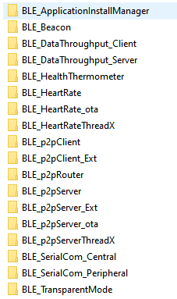
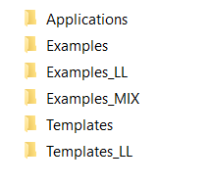
STM32CubeWBA Content 2/3
STM32CubeWBA MCU folder overview
various examples and application for the evaluation board
BLE application code examples
Evaluate & understand BLE APIs
Start prototyping from existing code (proprietary BLE profile)

Slide 14
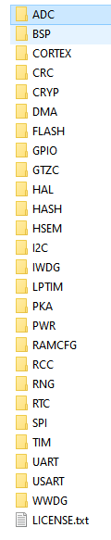
STM32CubeWBA Content 3/3
STM32CubeWBA MCU folder overview
various examples and application for the evaluation board
peripheral code examples
Peripheral applications running over NUCLEO HW

Slide 15

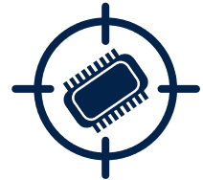



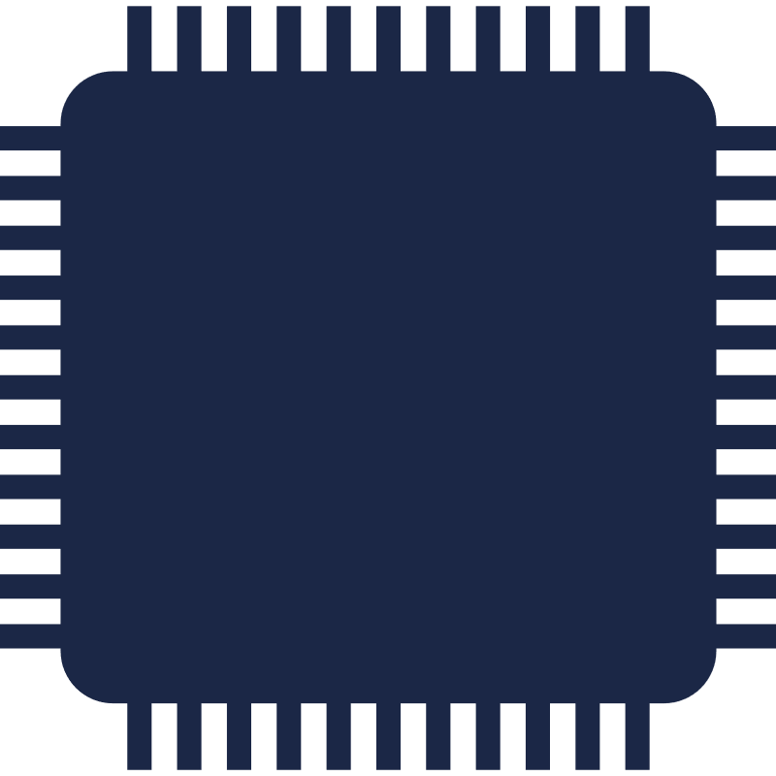
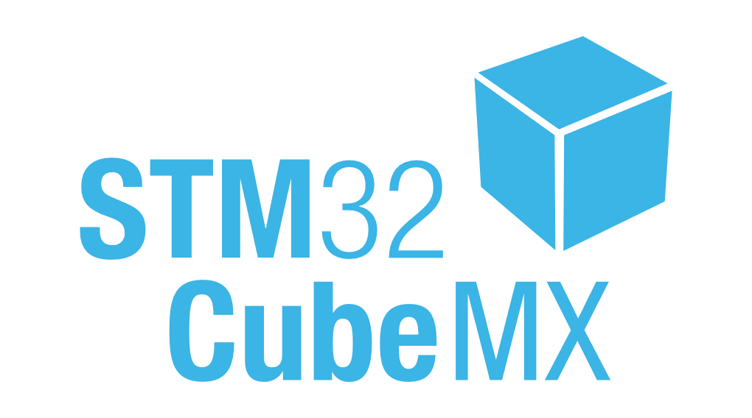



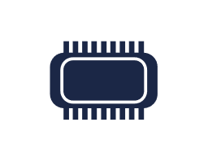


STM32CubeMX key steps Start your Design
Power consumption calculator
MCU / board / example selector
Code generation
Pinout configuration
Software components parameters
Clock Tree initialization
Peripherals configuration
I²C
SPI
UART
CAN

Slide 16




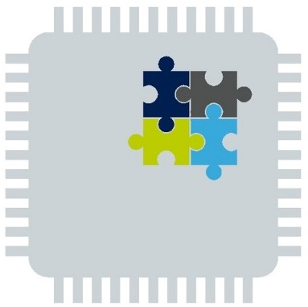

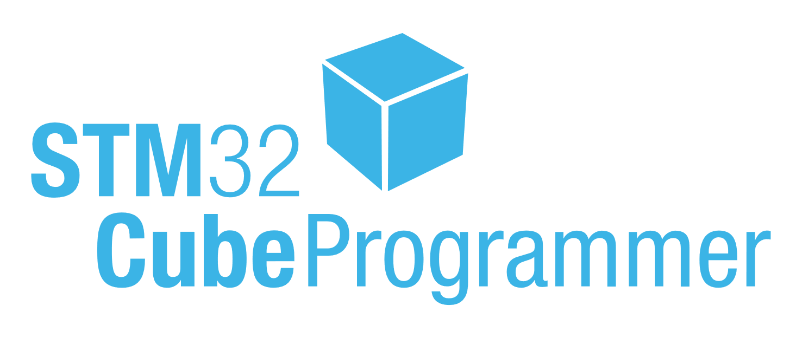


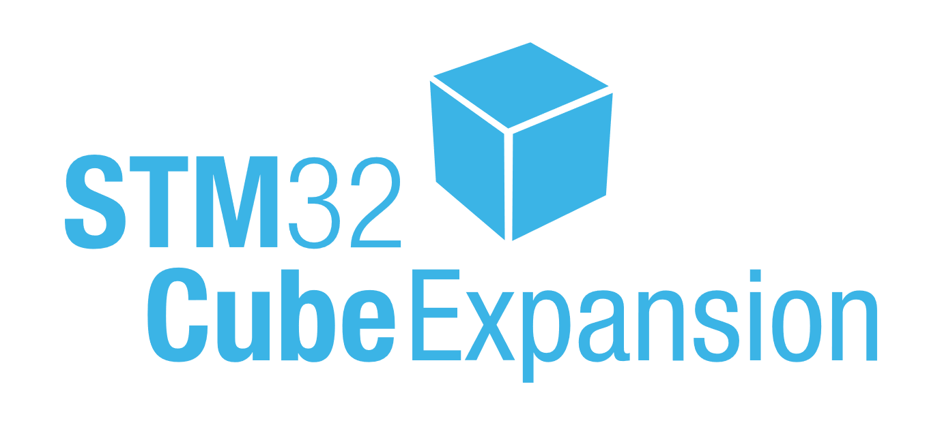
Leveraging STM32Cube software suite
Software tools
Embedded software
Complemented with Microsoft Azure RTOS
Packages
Azure RTOS
Configuration
Azure RTOS ThreadX
Real-time operating system
Development
User application
Azure RTOS FileX
FAT file system, fault tolerant
Middleware
Drivers
Azure RTOS NetX/NetX Duo
TCP/IP stacks
Programming
Expansions
Azure RTOS USBX
USB stack, host, and device
Monitor
Free-of-charge production license

Slide 17
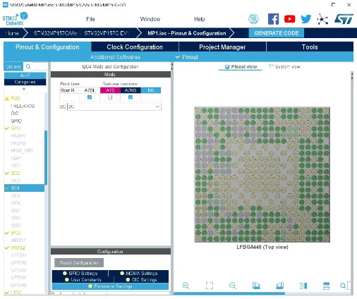
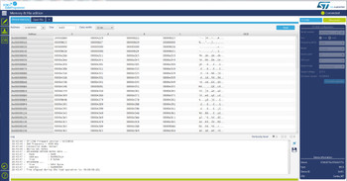

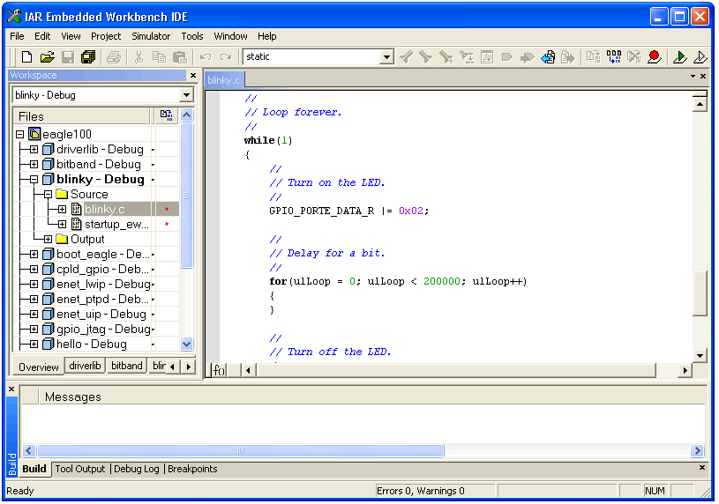
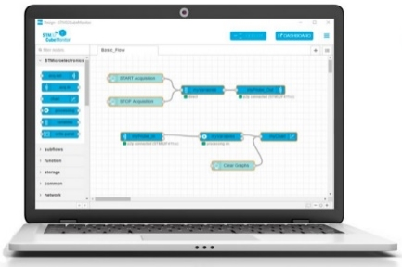
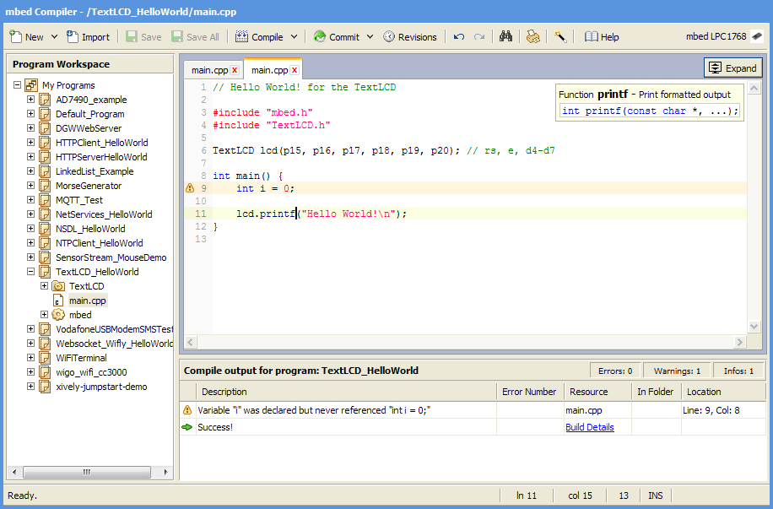
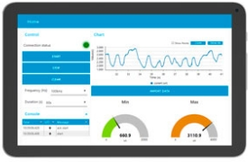



STM32WBx ecosystem Complete set of tools to ease your design
From an Idea to a certified product
STM32CubeMX
IDEs
Compile and debug
STM32 programming & monitoring tools
Graphical tool
for easy configuration
Configure and generate code
Peripherals and middleware configuration
Simple,
powerful solutions
Partners IDE (Arm® Keil®)
IDE based on Eclipse
RTOS aware debug
STM32CubeProg
STM32CubeMonitor
STM32CubeMonRF
Device and memory configuration
Program the application
Monitor variables at runtime , Test RF
Notes:
In the software offering we have STM32CubeMX which is our main configuration and production selection tool
Through CubeMX you can configure the Bluetooth radio, middlewares periperhal configuration and finally generating the initial application code to continue development
In terms of IDE’s we support the same IDE’s as our general purpose MCU’s
STM32CubeIDE which is our free eclipse based environment that you can use to develop, configure and download your code
We also have full support for KEIL and IAR on the STM32WBA
Finally to complete your project we have STM32CubeProgrammer which can be used to set option bytes, readback, erase and program the device
With STM32CubeMonitorRF allows you to perform precertification or just RF testing with our direct test mode application
With all of these tools it is clear to see the value proposition of using the Cube ecosystem for your development

Slide 18
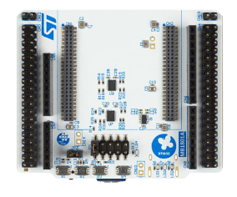
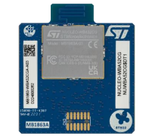

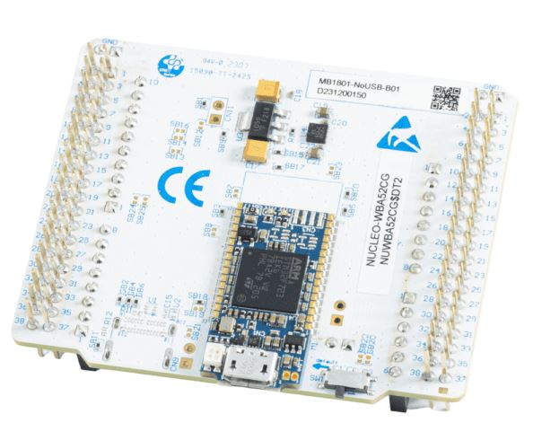

Connect the NUCLEO-WBA52CG to the PC
+
STM32WBA52CG
3 user LEDs
3 user buttons
STLINK-V3MODS
Programming
Debugging
VCOM

Slide 19
Hands on session: Let’s build P2P server with STM32Cube tools

Slide 20


What is a P2P Server?
P2P is a Generic Attribute Profile (GATT) based on Bluetooth LE defined by STM with propietary UUIDs 128bit
ST BLE Toolbox
GATT Client
GAP central
GATT Server
GAP peripheral
Notes:
What are we going to do?
Create device that can report values to mobile phone and accept commands from it
Example use cases: Thermostat, or any other home appliance with some sensor and some actuator
How are we going to do that? We will start from empty CubeMX project and add all peripherilas that BLE Middleware rely on. Then we will add some application code for sending and receiving data.

Slide 21
What is a P2P Server?
P2P is widely used for direct connection and defined connection between GATT Server and GATT Client
Notification - SWITCH
Write - LED
ST BLE Toolbox
GATT Client
GAP central
GATT Server
GAP peripheral
Notes:
What are we going to do?
Create device that can report values to mobile phone and accept commands from it
Example use cases: Thermostat, or any other home appliance with some sensor and some actuator
How are we going to do that? We will start from empty CubeMX project and add all peripherilas that BLE Middleware rely on. Then we will add some application code for sending and receiving data.

Slide 22
What is a P2P Server?
We will be able to control LED from Mobile and to get notification of LED status from Nucleo-WBA52
Notification - SWITCH
Write - LED
ST BLE Toolbox
GATT Client
GAP central
GATT Server
GAP peripheral
Notes:
What are we going to do?
Create device that can report values to mobile phone and accept commands from it
Example use cases: Thermostat, or any other home appliance with some sensor and some actuator
How are we going to do that? We will start from empty CubeMX project and add all peripherilas that BLE Middleware rely on. Then we will add some application code for sending and receiving data.

Slide 23
What is a P2P Server?
We will be able to have the notification on the Mobile that a button is pushed on the Nucleo-WBA52
Notification – PUSH BUTTON
ST BLE Toolbox
GATT Client
GAP central
GATT Server
GAP peripheral
Notes:
What are we going to do?
Create device that can report values to mobile phone and accept commands from it
Example use cases: Thermostat, or any other home appliance with some sensor and some actuator
How are we going to do that? We will start from empty CubeMX project and add all peripherilas that BLE Middleware rely on. Then we will add some application code for sending and receiving data.

Slide 24
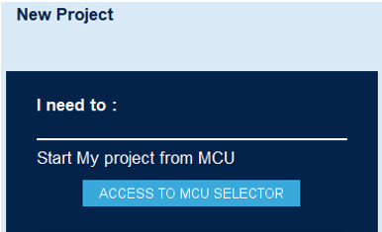
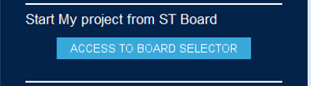
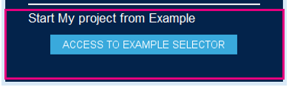
START STM32CubeMX Open BLE_P2PServer example
STM32CubeMx allows to start design within 3 options.
1
Chipset level
require to configure your HW (PCB) & your application
2
Board level
all the hardware is already configured (NUCLEO_WBA52)
3
Example application
complete application running over NUCLEO
For this session, we will start from BLE_p2pServer.ioc example

Slide 25
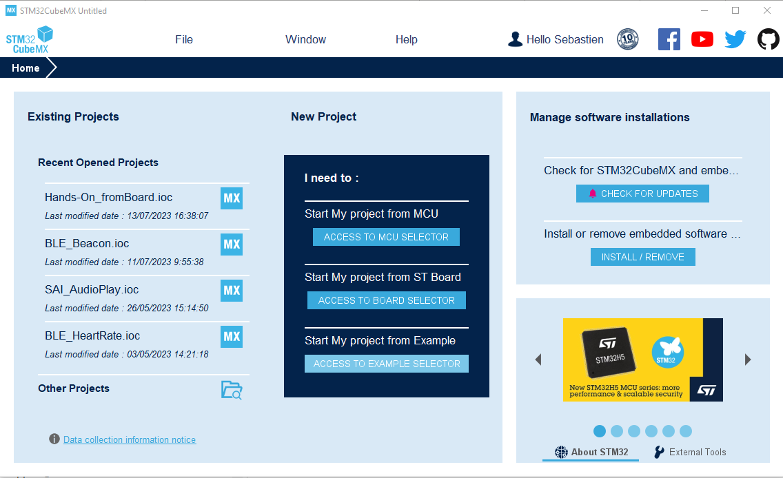

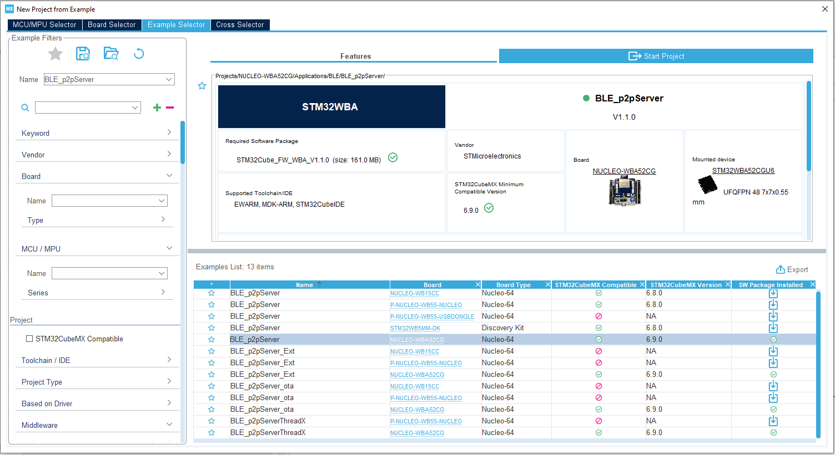
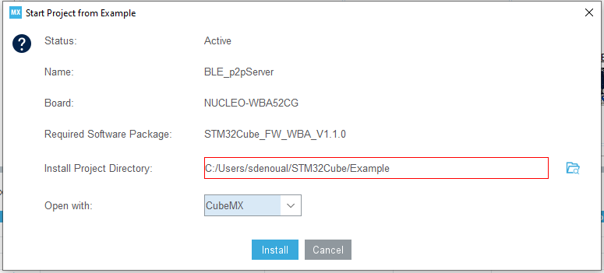
START STM32CubeMX Open BLE_P2PServer example
3
2
1
4

Slide 26
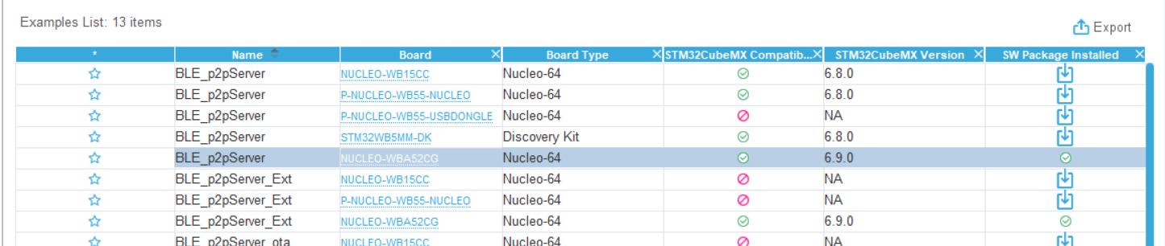
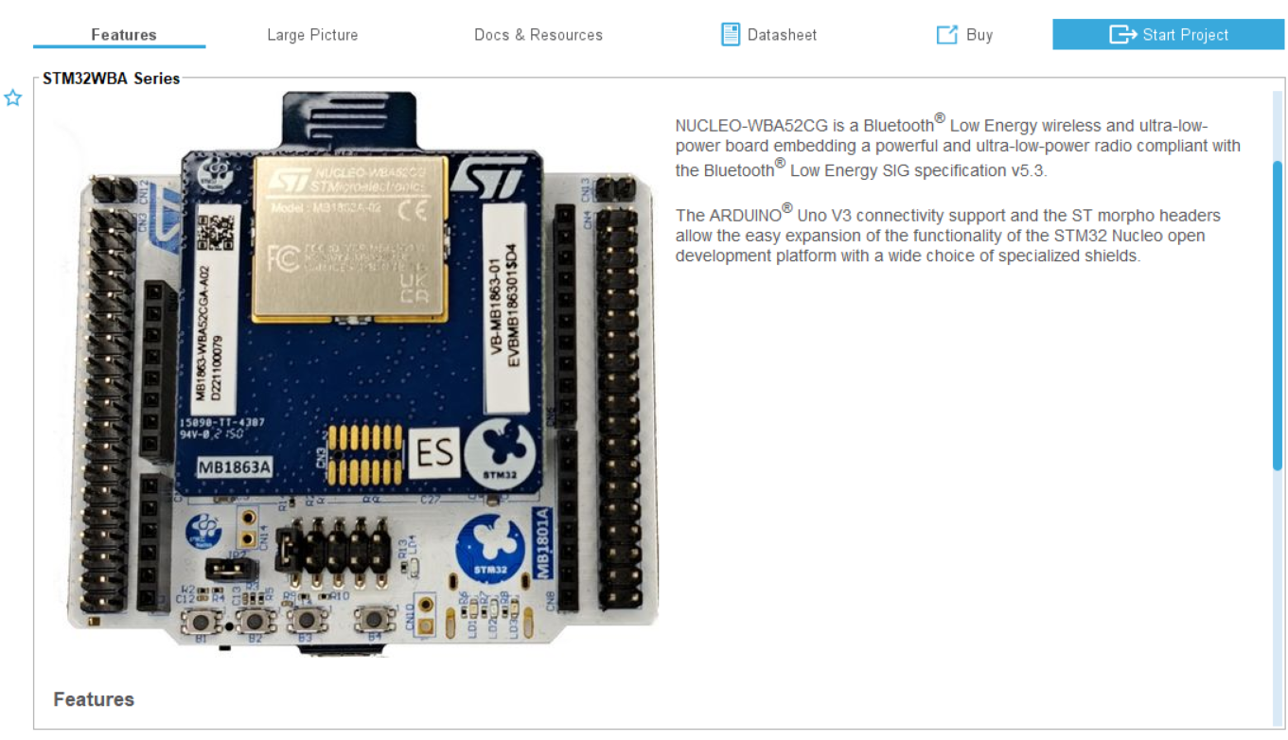
CubeMX – Nucleo Docs&Resources
1
2
! by Clicking on the Board type we can access all the Doc & Resources related to the Nucleo-WBA52 and more in general to the STM32 product family

Slide 27
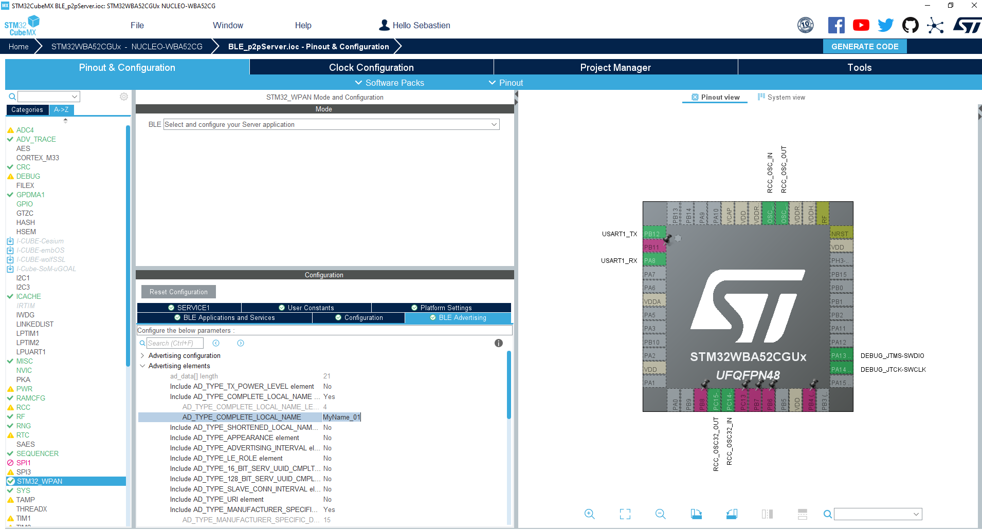

Customize Local Name
1
3
4
Local Name must be < 11
CubeMx contraints
2

Slide 28
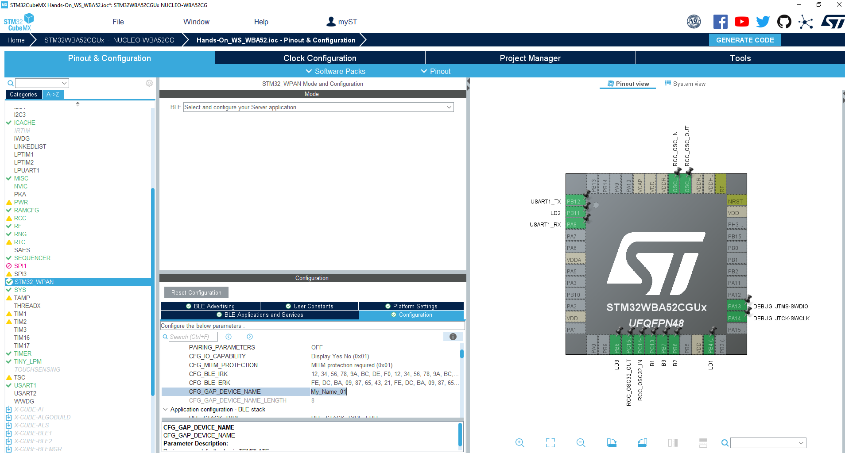
Customize Device Name
1
2
3
4
set same Device name =
Local Name
?
iOS displays Local Name (advertising data) prior to a 1st connexion.
After a 1st connexion iOS displays Device name (thanks to look up table : associates BLE MAC @ & Device Name)

Slide 29
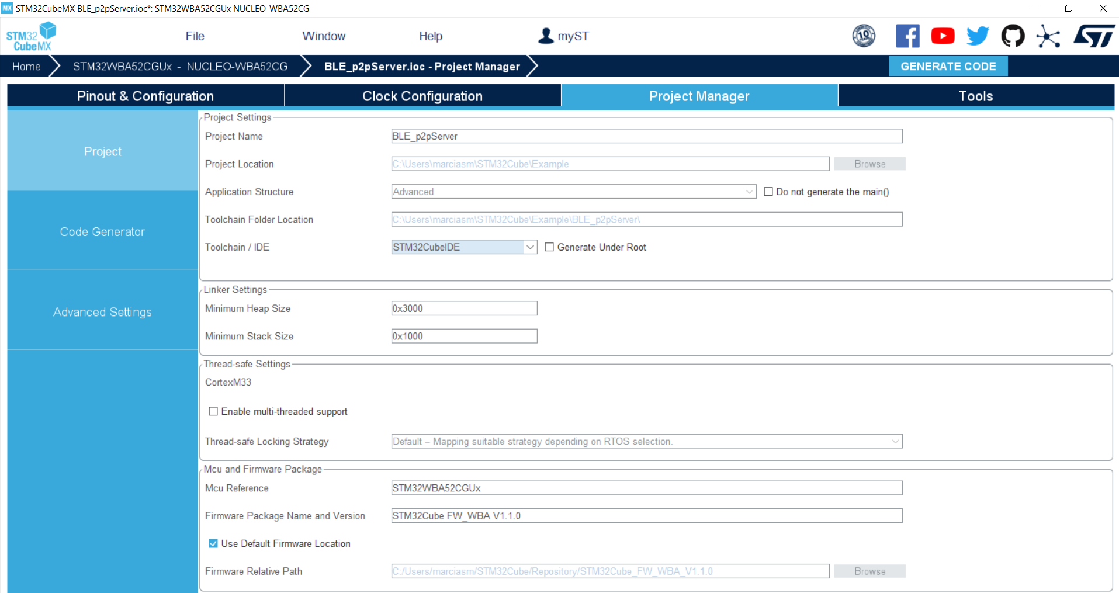
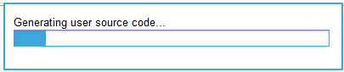
Generate code
3
1
2
Select here your favorite IDE

Slide 30
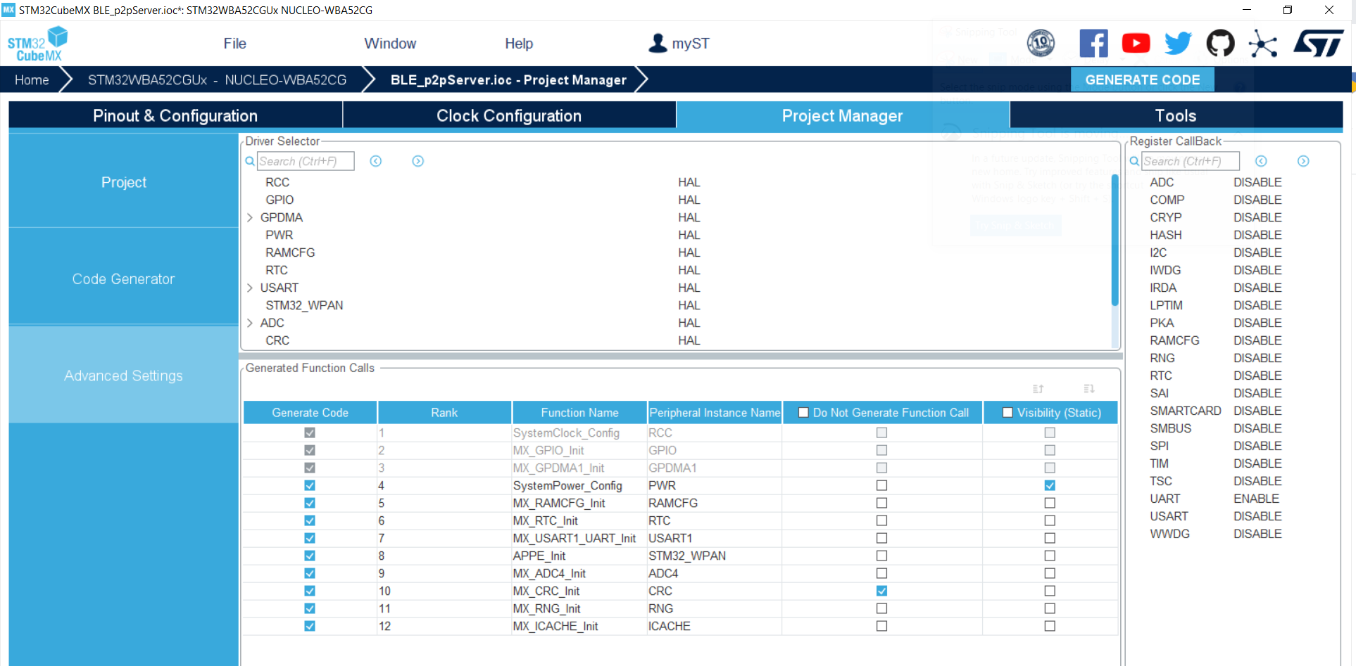
Advanced Settings
From this tab you’ve selected LL/ HAL for each driver
Enable the generation of callback define statements

Slide 31
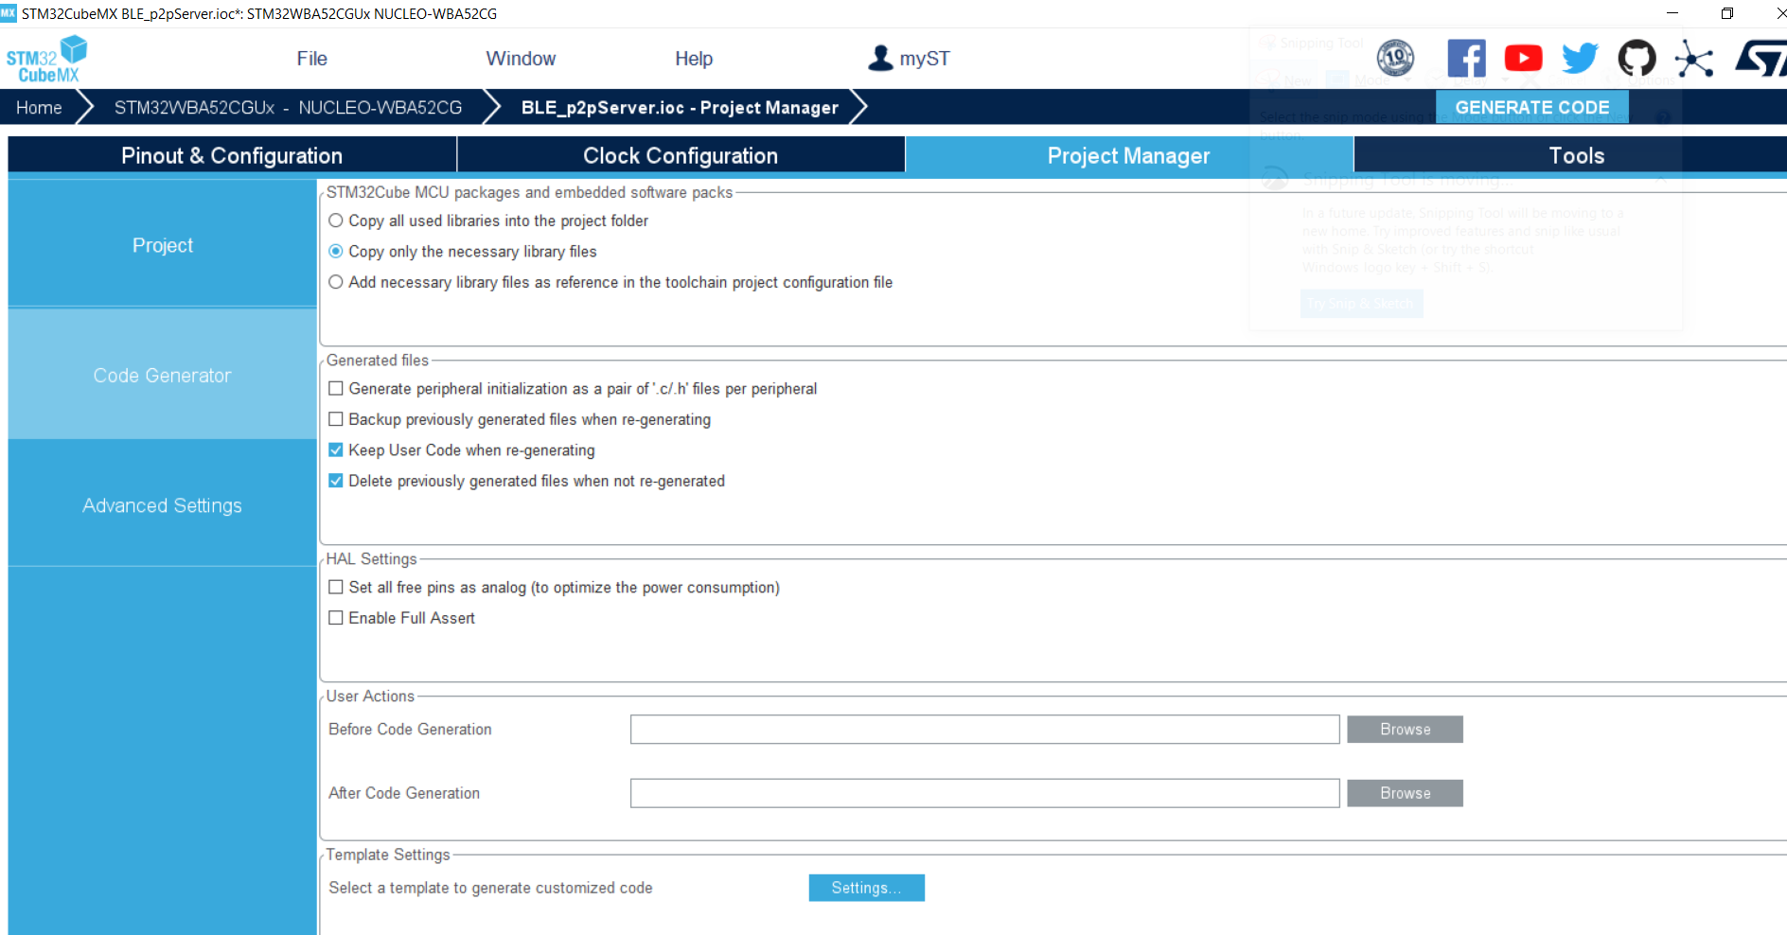
Code Generator
You can select how HAL .c/.h are included inside the project or backup the code that was generated previously
Here you can enable all pins as analog to save power

Slide 32
STM32WBx ecosystem Complete set of tools to ease your design
From an Idea to a certified product
STM32CubeMX
IDEs
Compile and debug
STM32 programming & monitoring tools
Graphical tool
for easy configuration
Configure and generate code
Peripherals and middleware configuration
Simple,
powerful solutions
Partners IDE (Arm® Keil®)
IDE based on Eclipse
RTOS aware debug
STM32CubeProg
STM32CubeMonitor
STM32CubeMonRF
Device and memory configuration
Program the application
Monitor variables at runtime , Test RF
Notes:
In the software offering we have STM32CubeMX which is our main configuration and production selection tool
Through CubeMX you can configure the Bluetooth radio, middlewares periperhal configuration and finally generating the initial application code to continue development
In terms of IDE’s we support the same IDE’s as our general purpose MCU’s
STM32CubeIDE which is our free eclipse based environment that you can use to develop, configure and download your code
We also have full support for KEIL and IAR on the STM32WBA
Finally to complete your project we have STM32CubeProgrammer which can be used to set option bytes, readback, erase and program the device
With STM32CubeMonitorRF allows you to perform precertification or just RF testing with our direct test mode application
With all of these tools it is clear to see the value proposition of using the Cube ecosystem for your development

Slide 33
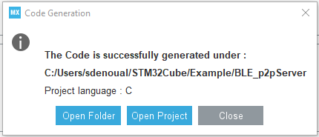

Open project
1
2

Slide 34





Build and flash modified project
1
Build
Plug the board
Flash
2
3

Slide 35

Code change with STM32 IDE

Slide 36


Enjoy your first STM32WBA52 project running!
ST BLE Toolbox

Slide 37
BLE sequences from Advertising to PUSH BUTTON notification

Slide 38



UART Terminal configuration
Terminal must be configured as defined in STM32CubeMX:
Debug traces are also enabled:

Slide 39

STBLE Toolbox (Advertising)
1
click on device

Slide 40

UART Terminal (Advertising)
Via the HyperTerminal, check the “Advertising” sequence after reset:
Creation of P2P service & characteristics
Advertising start

Slide 41


STBLE Toolbox (Connection)
1
2
click on connect
access to profile

Slide 42

UART Terminal (Connection & P2P profile)
Via the HyperTerminal, check the Connection sequence & P2P profile activation

Slide 43

STBLE Toolbox (LED)
Notification - SWITCH
Write - LED
control LED status on Nucleo

Slide 44

UART Terminal (LED)
Then check the LED1 characteristic:

Slide 45


STBLE Toolbox (Push Button)
1
2
Notification - SWITCH
push button 1 and notify device
click on details to see bytes sent/received

Slide 46
UART Terminal
Connect an HyperTerminal to check application :

Slide 47
HW project development & certification

Slide 48



A complete set of documentation
AN5948 : Development of RF Hardware using STM32WBA
RF basis generalities
Schematics & components selection guidelines
STM32WBA5x layout checklist & guidelines
Soon on st.com
STM32WBA5x resources on st.com
MB1863 STM32WBA52/54 QFN48 PCB antenna
Multiple reference design available for
various part numbers & packages
Download STM32WBA5x symbol
Download STM32WBA5x footprint

Slide 49


HW design with STM32WBA5x : key points
HW design should be initiated based on documentation shown on previous slides
Next slides are highlighting the key points you must pay attention when designing schematics and layout:
HSE 32MHz Xtal requirements:
STM32WBA5x includes internal programmable capacitances to trim the crystal frequency
No need external load capacitances
But, select 8pF load cap XTAL
Recommended part (or equivalent): NX1612SA-32MHZ-EXS00A-CS09166
Refer to AN5042 or ST team
LSE or LSI selection. LSE 32kHz Xtal requirements if used:
LSE mandatory for accurate RTC calendar application
BOM optimized (save 32kHz Xtal cost) with LSI (OSC32 pins can be used open of as IOs)
Refer to AN2867 or ST team
Notes:
1 or few µAM

Slide 50


HW design with STM32WBA5x : key points
RF matching & filtering:
Integrated balun​ so single ended RF matching.
Very limited number of discrete components for STM32WBAx matching and filtering.
Power management. SMPS implementation for STM32WBA55 (next WBA version) use case:
STM32WBA55 embeds a SMPS that can be used to improve power efficiency.
Apply different power supply scheme for output power target > 4dBm.
Main layout recommendation:
Refer our various reference kits layout (Gerbers and Altium files available). ​
4 layers stack-up recommended but 2 layers one is possible. ​

Slide 51

STM32WBA5x : a certified solution
STM32WBA5x is compliant in regards of regional (CE, FCC etc.) and Bluetooth requirements.
We are providing complete set of documentation, FW and tools to certify your product.
Full set of tools and documentation
Certification guideline on wiki https://wiki.st.com/stm32mcu/wiki/Category:BLE_Certification
Transparent mode FW available in STM32CubeWBA MCU Package
STM32CubeMonRF PC tool

Slide 52

Bluetooth certification
STM32WBA5x is having reference QDIDs (components and stack) at Bluetooth SIG.
Customer musty performed PHY testing and declare its product at Bluetooth SIG.
PHY QDID
Package | Part number | Cut version | RF PHY QDID
QFN48 | STM32WBA52 (BLE5.4) | 1.x | 197135 (TCRL 2022-2)
Stack QDID
Features | Host Stack version | QDID
4.0 HCI Low Energy LL with extended advertising – ATT – GAP – GATT – L2CAP with Enhanced Connected Oriented Channel -SMP BLE 5.3 | STM32Cube_WBA_BLE_HCI_STACK STM32Cube_WBA_BLE_FULL_STACK | 198195 (TCRL 2022-1)
https://wiki.st.com/stm32mcu/wiki/Category:BLE_Certification
52

Slide 53
ST EMEA support

Slide 54

What you can expect from our wireless support team
Senior expertise in wireless communication (RF and HW bring-up services, SW and HW debugging, Schematic and layout review)
Automated Pre-certification capabilities
EMEA dedicated application labs
Knowledge on your application
... in a fast and agile way

Slide 55
Our customer wireless journey and how we can help
Support them to make the right choice
Make sure their choice was the right one
ST Product selection
ST Product evaluation
SW and HW Development
Testing and certification
Industrialization
Training
Benchmark
Datasheet review
Eval kit bring-up
Performance review
Schematic review
Layout review
Software porting
1st PCB bring-up
1st RF test report
Debugging
Regional RF test report
Protocol RF tests
Corner case debugging
Certification process guidance
RF Production tooling
Ramp-up support
Don’t wait too long to ask for any support.
The sooner the better!!

Slide 56










We look forward to receiving customers’ PCBs!
Fully equipped lab with skilled team
PCB bring-up
& power consumption optimization
BLE & 802.15.4
Sub-1GHz

Slide 57
STM32WBA takeaway

Slide 58

STM32WBA takeaway 1#2
2.4Ghz Portfolio
Wide portfolio from NP to AP
from M0 to M33 – single or dual core
Wireless
Bluetooth® Low Energy 5.3 certified Multiprotocol
STM32WBA
Performance
Arm® Cortex®-M33 at 100 MHz Fast wake-up time , high RF power 10dBm
Power efficiency
Extended battery lifetime
Autonomous low-power mode
Security
As a MUST to have !
TrustZone® - DPA resistant – SESIP L3
Integration
1 Mbyte of flash memory, 128 Kbytes RAM Reduced BOM
Notes:
Now that we have gone through the details on the STM32WBA let’s summarize the value proposition to your next project
The STM32WBA is compliant to Bluetooth 5.3 including long range, 2Mbps and advertising extensions
We integrate our highest performing Bluetooth SoC core at 100MHz enabling fast wakeup times
We have multiple power modes for you to reduce the power consumption in your end application
We integrated our highest level of security with a Cortex M33 Trustzone core, the DPA resistant hardware and the Hardware Unique Key
With 1Mbyte of flash, 128Kbyte SRAM, integrated BALUN and the ability to use a single crystal for operation, this reduces your overall BOM
Finally the STM32WBA is integrated into our world class CubeEcosystem which provide the easiest and quickest path from prototype to production

Slide 59
STM32WBA takeaway 2#2
STM32WBA
Cost Effective
new architecture , 40nm
Large Capacity
Massive investment to support large production now and onward
Free ecosystem
Faster time to market with STM32CubeMX
Enhanced design journey
RF lab
Schematic & layout review to quickly go in production
Notes:
Now that we have gone through the details on the STM32WBA let’s summarize the value proposition to your next project
The STM32WBA is compliant to Bluetooth 5.3 including long range, 2Mbps and advertising extensions
We integrate our highest performing Bluetooth SoC core at 100MHz enabling fast wakeup times
We have multiple power modes for you to reduce the power consumption in your end application
We integrated our highest level of security with a Cortex M33 Trustzone core, the DPA resistant hardware and the Hardware Unique Key
With 1Mbyte of flash, 128Kbyte SRAM, integrated BALUN and the ability to use a single crystal for operation, this reduces your overall BOM
Finally the STM32WBA is integrated into our world class CubeEcosystem which provide the easiest and quickest path from prototype to production

Slide 60


You can personalize this
last page with a short link
(ex. www.st.com/shortlink)
You can find a complete list of st.com short links on this page:
http://seo.st.com/toolbox/shortcuts/
Find out more at www.st.com

Slide 61

Please remove this page
before publishing the
presentation
For further support in creating a PowerPoint presentation, including graphic assets, formatting tools and additional information on the ST brand
you can visit the ST Brand Portal https://brandportal.st.com

